Slide 1
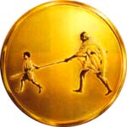
Value Added Course
MGM BLS
Mahatma Gandhi Mission
MGM
SKILLS LAB

Slide 2




AMERICAN COLLEGE OF SURGEONS AND ATLS(I) ACCREDIATED ATLS & ATCN

Slide 3
TEAM DYNAMICS

Slide 4
OVERVIEW
Successful team dynamics is critical during multirescuer resuscitation attempt, regardless of location
Effective team dynamics may increase the chance of a successful resuscitation.

Slide 5
Learning objectives
Describe the importance of teams in multirescuer resuscitation.
Perform as an effective team member during multirescuer CPR.

Slide 6
ELEMENTS PF EFFECTIVE TEAM DYNAMICS
Roles during a resuscitation attempt
- clear roles and responsibilities
- knowing your limitations
- constructive intervention
What to communicate
- knowledge sharing
- summarizing and reevaluating.
How to communicate
- closed loop communication
- clear messages
- mutual respect

Slide 7
Clear roles and responsibilities
During a resuscitation attempt clear roles and responsibilities should be defined as soon as possible.
The team leader’s role is to delegate tasks according to each team members skill level
When all team members know their jobs and responsibilities, the team functions more smoothly.

Slide 8
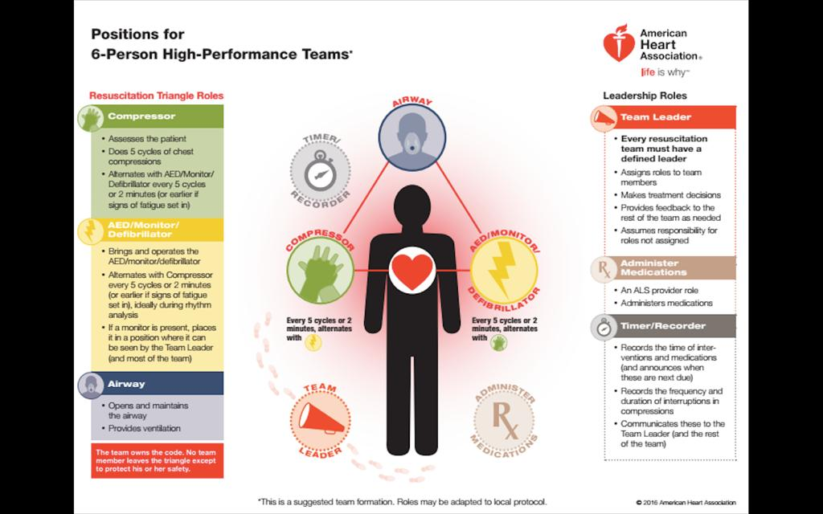

Slide 9
Knowing your limitations
Every member on the team should know his or her limitations, and the team leader should be aware of them.
Each team member should ask for assistance should ask for assistance and advice early.

Slide 10
Constructive intervention
Sometimes a team member or team leader may need to correct actions that are inappropriate
It is important to be tactful.
Any person no the team should stop someone else from making a mistake regardless of the person’s role on the team.

Slide 11
Knowledge sharing
Team leader should ask frequently for observations and feedback.
This includes good ideas for management and observations about possible oversight.

Slide 12
Summarizing and reevaluating
Summarizing information out loud is helpful during a resuscitation attempt fot the following reasons:
-Provides an ongoing record of treatment
-Acts as a way to reevaluate the victims status,the interventions performed, and the team’s progress within the algorithm
- Helps team members respond to the victims changing condition.

Slide 13
Closed loop communication
Closed loop communication is important for both the team leader and team members.
TEAM LEADER | Call each team member by name and make eye contact while giving instructions. Don’t assign additional task until you are sure that the team member understands the instructions
TEAM MEMBERS | Confirm that you understand each task to which you are assigned by verbally acknowledging the task. Tell the team leader when you have finished a task.

Slide 14
Clear Messages
Team leaders and team members should give clear messages.
Using concise, clear language helps prevent misunderstandings.
Speaking in a tone of voice that is loud enough to hear but also calm and confident, helps keep all team members focused.

Slide 15
Mutual Respect
All team members shuld display mutual respect and a professional attitude to other team members
The team leader should speak in a friendly controlled voice and avoid shouting or aggression.

Slide 16
Debriefing
Debriefing is the opportunity for team members to identify why certain actions were taken
It has shown to help team members perform better
It aids in identification of system strengths and defeciencies.

